Slide 1
STOCKWISE
Inventory Management System
Data Structures — Lab Project
INVENTORY,
UNDER CONTROL
Submitted by: Erragunta Aapti Reddy (PRN: 25070721018) | Yennam Krithika Reddy (PRN: 25070721062) CSE • Symbiosis Institute of Technology, Hyderabad

Slide 2
Project Overview
An inventory management system for tracking products, stock and prices
Purpose
Core features
Technology
Replace notebooks and spreadsheets with a digital system
Add, update, delete, search and sort products
C programming language
BST, Searching, and Sorting
Dashboard with live inventory statistics
Locate products and update records quickly
Low-stock and out-of-stock monitoring
Identify items that need restocking
Dashboard shows total products, units in stock, inventory value and stock alerts.
Demonstrates real-world use of Data Structures and Algorithms.

Slide 3
System Workflow
From logging in to managing, processing and storing inventory data
1. Login
Admin enters credentials to access the application
2. Dashboard
Inventory statistics and stock information are displayed
3. Manage
products
Add new products, edit existing records, delete unwanted ones
4. Process
data
Search and sort algorithms run; SKUs build a Binary Search Tree
5. Monitor & save
Low / out-of-stock flagged; data saved in Local Storage
→
→
→
→
Stored data remains available even after refreshing the page.
Inventory records can be exported as a CSV file.

Slide 4
System Modules
Each module handles a different part of the application
Login Module
Dashboard Module
Inventory Management
Module
Add new products
Provides an administrator login interface
Displays total products
Shows total units in stock
Allows access to the inventory dashboard
Calculates inventory value
Edit product details
Displays low-stock and out-of-stock products
Delete products
Search by name, category or SKU
Sort by name, SKU, quantity or price
Export inventory records as CSV

Slide 5
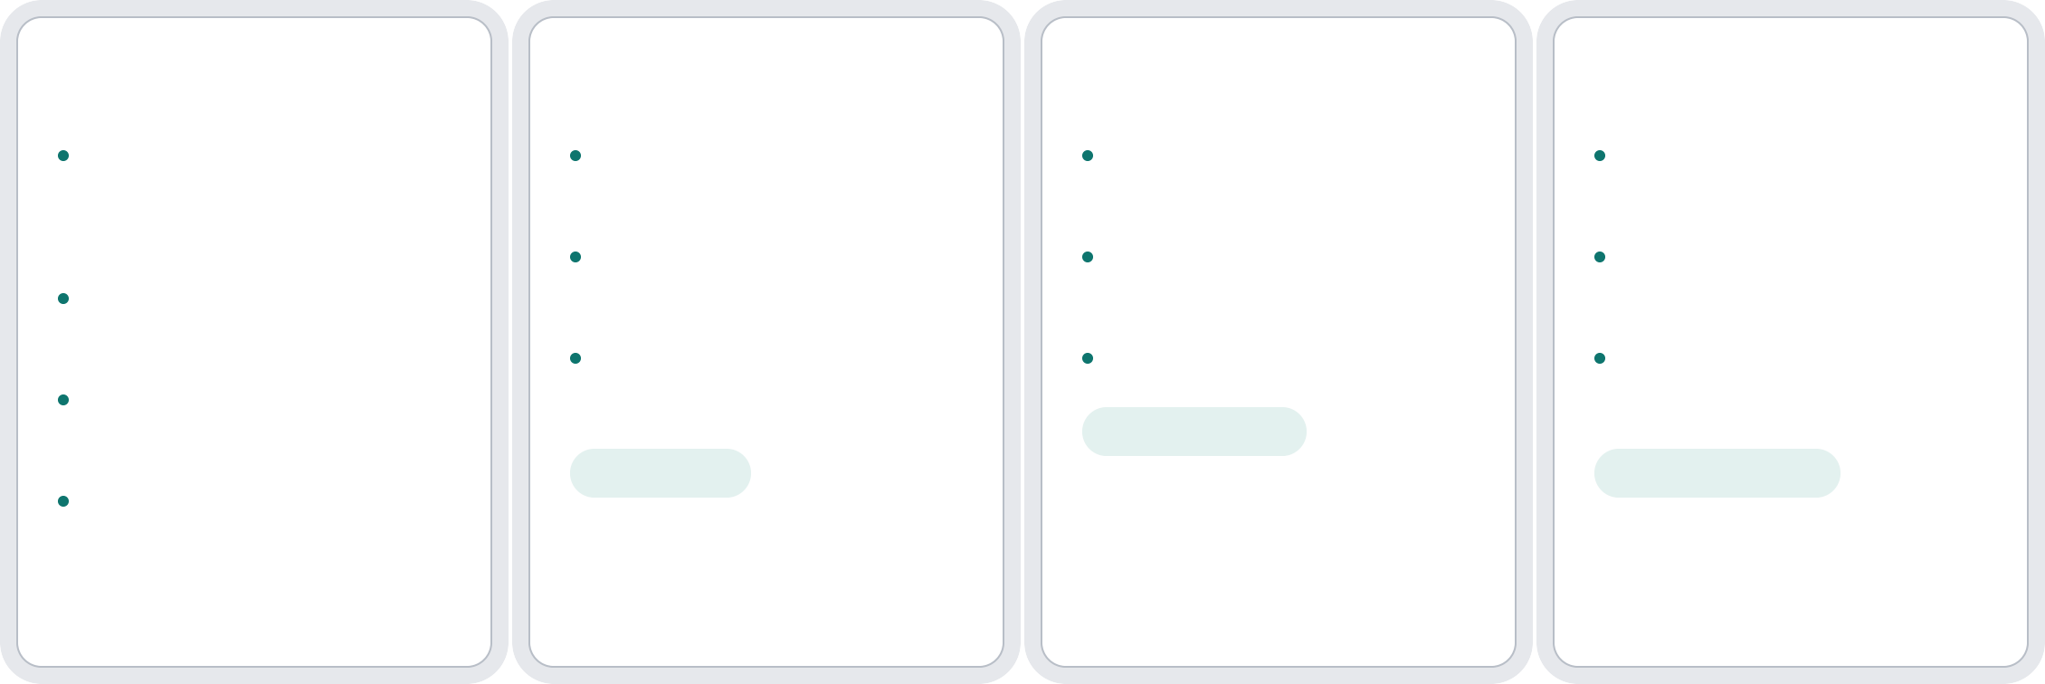
Data Structures & Algorithms Used
Numeric product SKUs and product lists drive the searching and sorting
Binary Search Tree
Linear Search
Binary Search
Merge Sort
Left subtree holds smaller values, right holds greater
Checks products one by one
Finds a product by numeric SKU
Divide-and-conquer
technique
Used for name or category search
Repeatedly halves the sorted range
Splits list into smaller sections and sorts each
Each node represents a product SKU
Does not need sorted data
Requires sorted data
Merges sections into one sorted list
Inorder (L+Root→R)
gives ascending order
Time: O(log n)
Preorder: Root→L+R
Time: O(n)
Time: O(n log n)

Slide 6
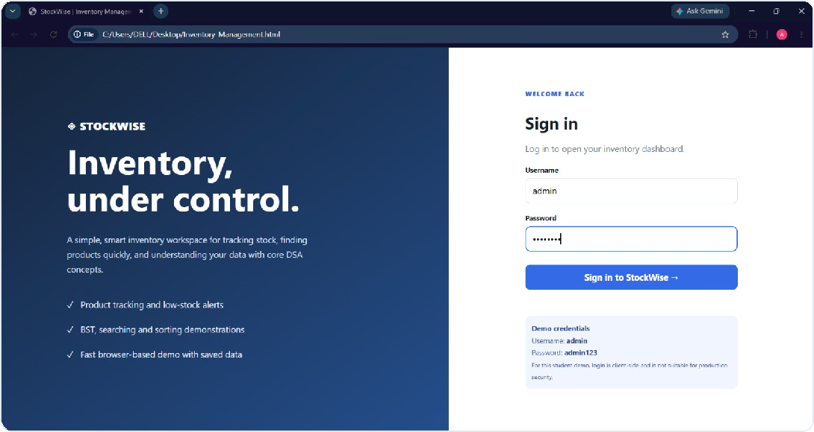
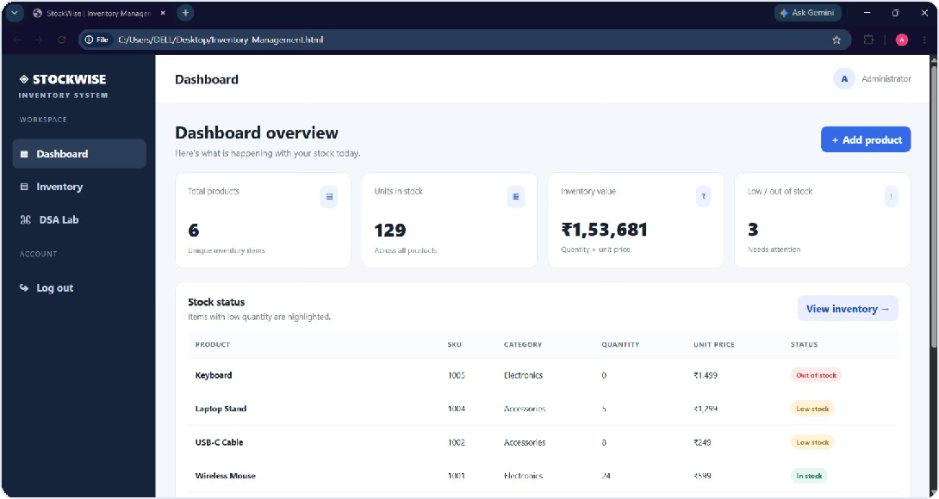
Web Application Screens
Login page and dashboard of the StockWise prototype
Login page – gives access to the dashboard
Dashboard – statistics and stock status

Slide 7
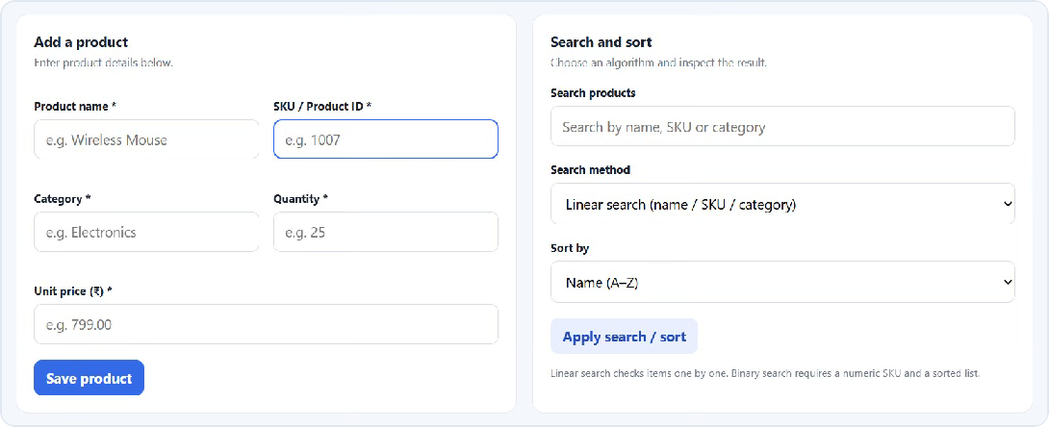
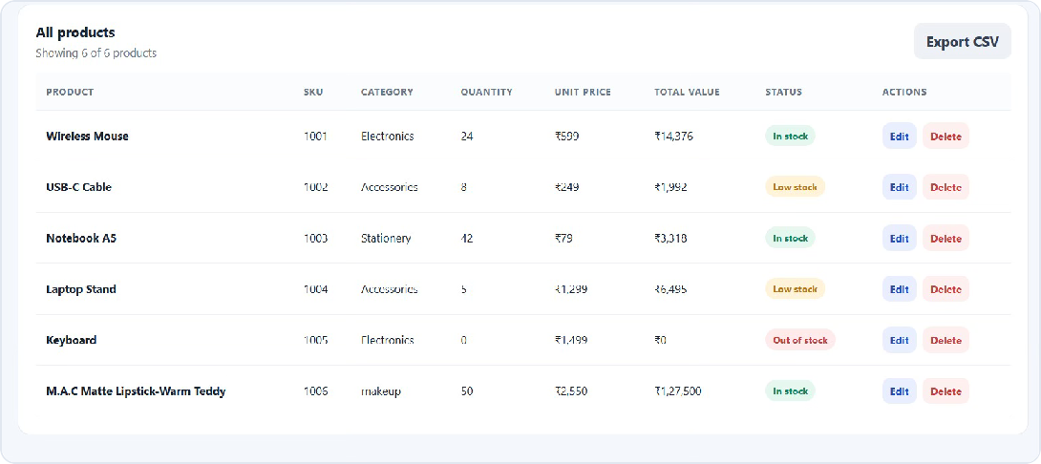
Managing Inventory
Adding, searching, sorting and viewing all products
Add product, search and sort controls
Updated data of all products (with CSV export)

Slide 8
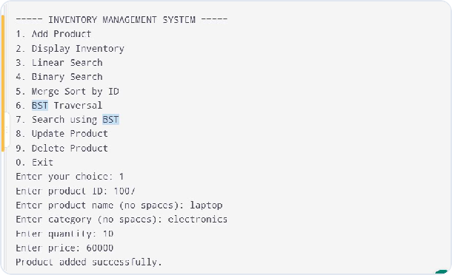
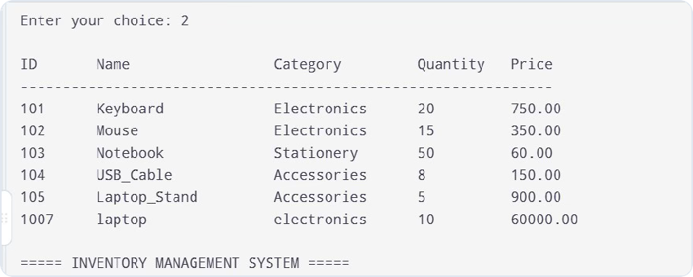
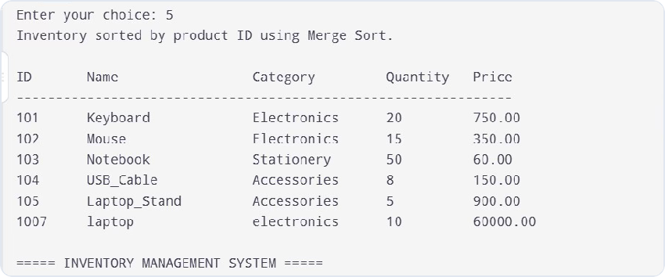
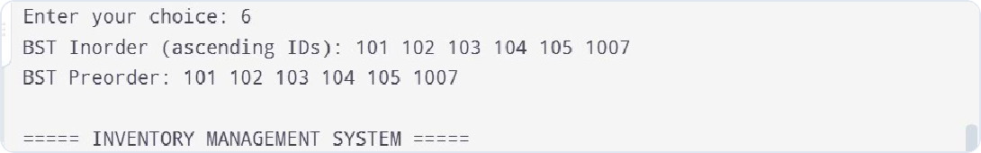
Console Output Demonstration
Menu-driven run of the core data-structure operations
Menu and add product
Display inventory
BST traversal – inorder and preorder
Merge Sort by ID

Slide 9
Applications & Future Scope
Where the system can be used and what can be added
Applications
Retail stores: products, prices and available stock Supermarkets: records and low-stock products Warehouses: organizing large numbers of records Stationery shops: notebooks, pens and more Small businesses: basic digital inventory
Future enhancements
Database integration using MySQL or MongoDB Multiple user accounts and role-based access Barcode and QR-code scanning
Supplier and purchase management Automatic low-stock notifications Inventory reports, charts and cloud storage

Slide 10
Conclusion
Built StockWise, an Inventory Management System.
A Binary Search Tree organizes product SKUs; Linear and Binary Search locate products.
Merge Sort orders products by name, SKU, quantity or price.
The dashboard highlights low-stock and out-of-stock items.
The project demonstrates practical DSA concepts and can be extended with databases and scanning.
THANK YOU
Project guide: Dr. Rakesh Salakapuri • Symbiosis Institute of Technology, Hyderabad

